Slide 1
NE 591: Advanced Reactor Materials
Fall 2021
Dr. Benjamin Beeler

Slide 2
Last Time
DFT overview

Slide 3
Carbides and nitrides

Slide 4
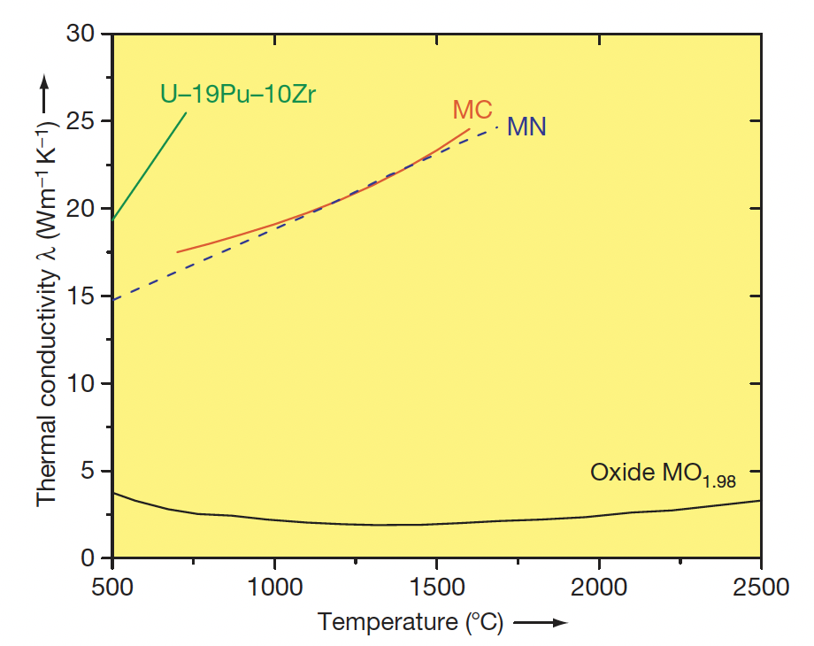
Why Carbides?
Possible fuel compositions with higher fissile atom density are nonoxide ceramics, for example, uranium–plutonium-mixed carbide or nitride
These fuels have higher thermal conductivity, high fissile heavy-atom density, and a high melting point compared to metallic fuel
The higher thermal conductivity of carbide fuel and high melting point makes carbide fuel suitable for operation at high power

Slide 5
Why Carbides?
The more efficient heat transfer also allows for the possibility of large diameter fuel pins, with more fissile material per pin, and more power generation
High-specific-power operation permits fewer pins, compared to oxide, and a more compact core, which can reduce plant costs
A large amount of development work on carbide and nitride fuels was performed from 1960 to 1970, and more than 5000 advanced fuel pins have been fabricated and irradiated
The practical difficulty of fabrication of carbide fuel hampered carbide development
The high-purity inert cover gas required for fuel fabrication was expensive and maintenance of C/M ratio was difficult

Slide 6
Carbide Reactor
The Indian FBR program, however, started with the introduction of plutonium-rich mixed uranium–plutonium carbide as the driver fuel for 40MWth loop-type fast breeder test reactor (FBTR)
The reactor became critical in the year 1985 and it is the only reactor operative on a full core of carbide fuel
Carbide fuel cannot be used in LWR because of its incompatibility with the coolant
However, it can be safely used with liquid metal (Na or lead) or gas cooled (CO2 or He) in Gen-IV type of high-temperature reactor
Carbide fuel has a breeding ratio of at least 1.30, a doubling time of 15 years or less, and the burnup limit of more than 15 at.%

Slide 7
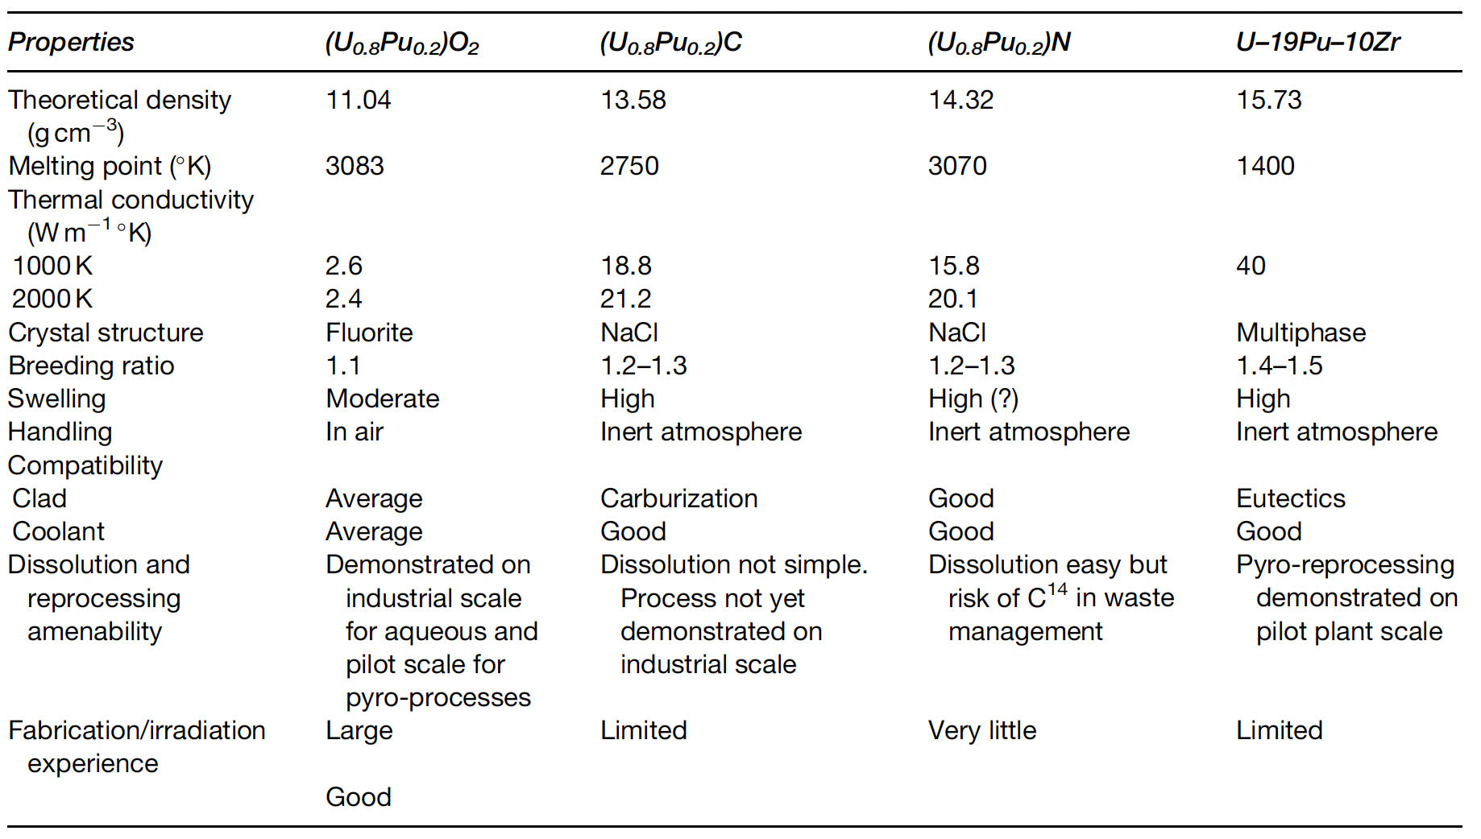
US Interest in Carbide Fuels
Following the oil crisis in 1974, a national advanced liquid-metal-cooled fast breeder reactor (LMFBR) fuels development program was initiated that built upon early years of carbide fuel development
Both carbide and nitride fuels offer a middle ground for LMFBR performance because of their higher thermal conductivity, fissile-atom density, and chemical compatibility with liquid sodium, and much higher melting point than metallic fuels

Slide 8
Carbide Pin Designs
There are two concepts available for the carbide fuel pin depending upon the type of bond between the fuel pellet and the cladding material: He-bonded and Na-bonded carbide fuels
The average operating fuel temperature of the He-bonded pin is high because of low thermal conductivity of the He bond compared to the Na bond
This design requires a larger fuel–clad gap and 85% smear density to accommodate the swelling of the fuel
The fission gas release in a He-bonded pin will be higher compared to that from a sodium-bonded pin, due to the higher temperatures
Na-bonded carbide fuel pins also require a reduced smear density compared to oxide fuels to account for fuel swelling
The purity of the Na bond is very important, requiring strict tolerances on O content

Slide 9
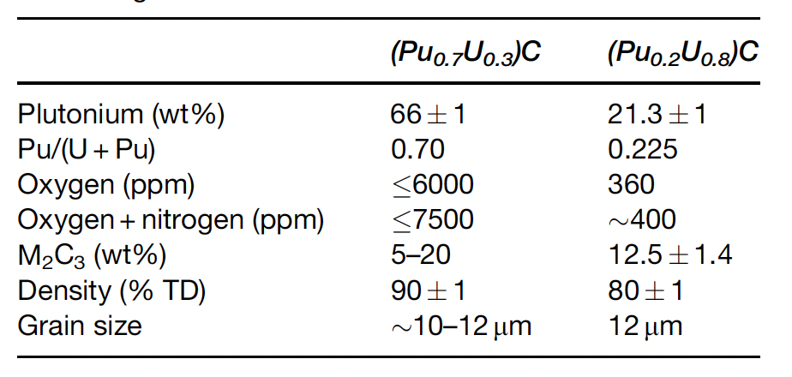
Carbide Fuel Details
A hyperstoichiometric (C/M>1, carbon to metal ratio) fuel composition is chosen so that it contains some amount of sesquicarbide M2C3 phase (M=U+Pu), which accounts for the decrease in (C/M) ratio with burnup
A sufficiently low C/M ratio may result in the formation of actinide metal phases, which may form low-melting eutectic with the cladding and limit the life of the fuel pin
FCMI can potentially exist, depending upon the operating temperature of the fuel
O and N impurities play important roles, as they act as ‘carbon equivalent’, which affect the carbon potential of the fuel

Slide 10
U-C Phases
UC2 has a fcc fluorite structure at high temperature and transforms to a body-centered tetragonal structure at 1820C
The UC2 phase is retained in a metastable form in material rapidly cooled from the melt
As-cast hyper stoichiometric UC consists of a Widmanstatten pattern of UC2 platelets on the {100} planes of the face-centered cubic UC matrix

Slide 11
NE 591: Advanced Reactor Materials
Fall 2021
Dr. Benjamin Beeler

Slide 12
Last Time
QE overview
Carbides have higher U density and better thermal conductivity than UO2, and a higher melting point than metallic fuel
Carbide fuels are used as a breeder or burner fuel, with a Na or He bond

Slide 13
Key Properties
The thermophysical properties that are of importance and affect the fuel performance are solidus/liquidus temperature, thermal conductivity, coefficient of thermal expansion, elastic/fracture properties, creep, and hardness at ambient and at high temperatures
The solidus/liquidus temperatures along with thermal conductivity limit the fuel operating temperature in terms of linear heating rate
Thermal conductivity determines rate of heat transfer out of fuel and into the cladding
Thermal conductivity varies as a function of density, porosity (shape, size, and distribution), composition, presence of a second phase, grain size, etc.
Coefficient of thermal expansion is an important design parameter, the stresses generated in the fuel and by the fuel in the cladding are partly due to the difference in the CTE between the fuel and the cladding

Slide 14
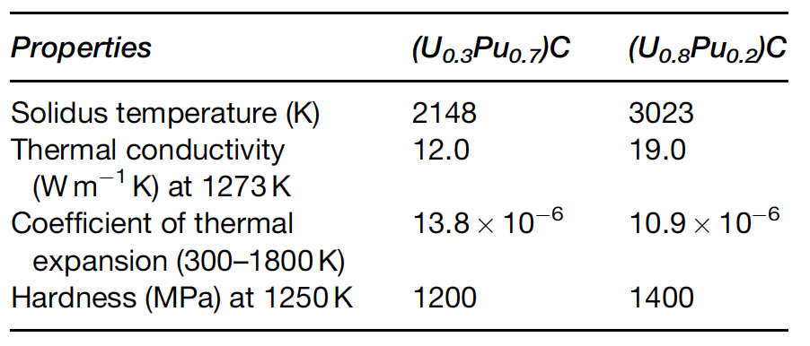
Key Properties
The elastic and fracture properties of the fuel are primarily responsible for the extent and severity of FCMI
Both thermal-induced and irradiation- induced creep of the fuel also determine the extent of FCMI
Mechanical and creep properties depend on composition, second phases, grain size, etc.
Pu lowers melting point, decreases thermal conductivity, increases expansion, and softens the fuel

Slide 15
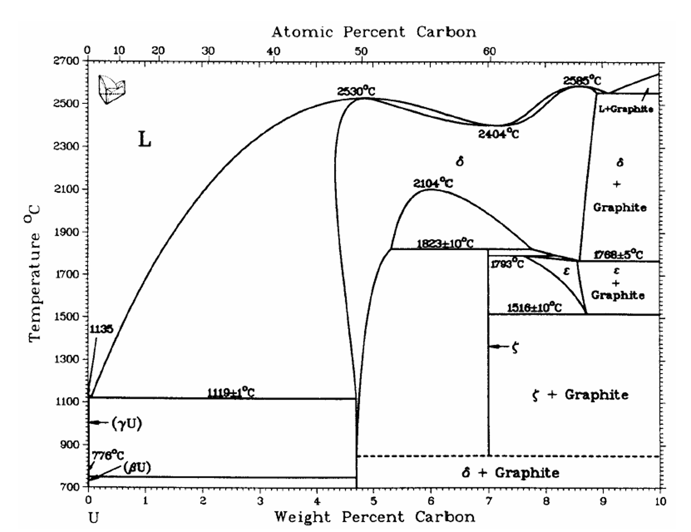
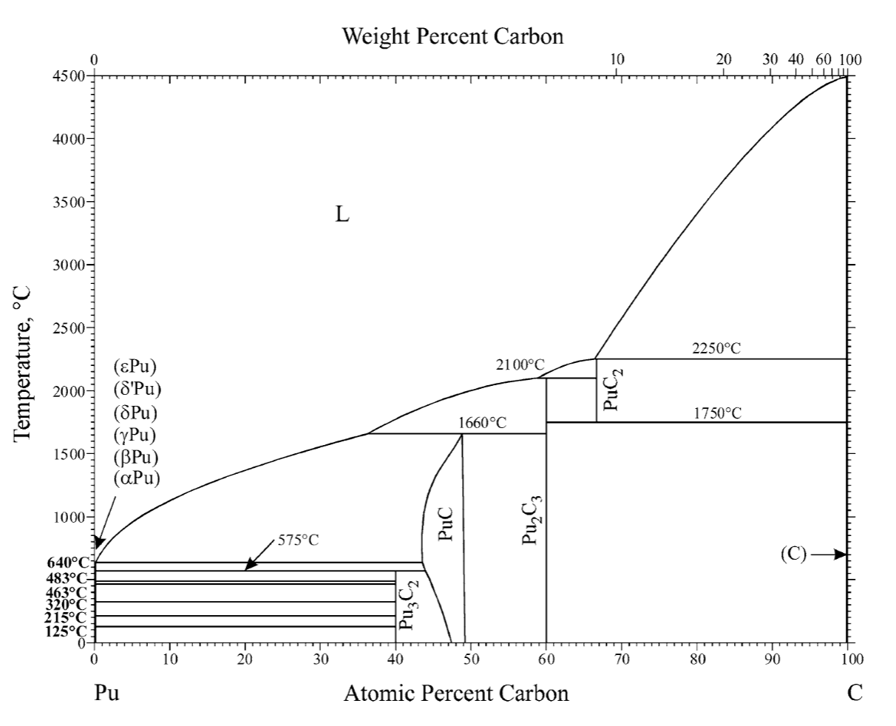
Phase Diagrams of Carbides

Slide 16
U/Pu-C Chemistry
Uranium forms three compounds with carbon: UC, U2C3, and UC2
U2C3 has a fixed stoichiometry (is a line compound)
UC is stable over a wide temperature and composition range, with a melting point of ~2800 K
UC2 is stable in two phases, alpha-UC2 and beta-UC2
U2C3 decomposes into UC+alpha-UC2 on heating from 2096 to 2110K and into UC+C below 1400 K
The Pu–C system has four compounds: Pu3C2, PuC1–x, Pu2C3, and PuC2
The compound Pu3C2 decomposes into Pu+PuC at 848 K
The differences in the UC/PuC diagrams are mainly due to (i) the presence of Pu3C2 compound, (ii) the low stability of PuC compared to UC, and (iii) the high stability of Pu2C3 compared to U2C3

Slide 17
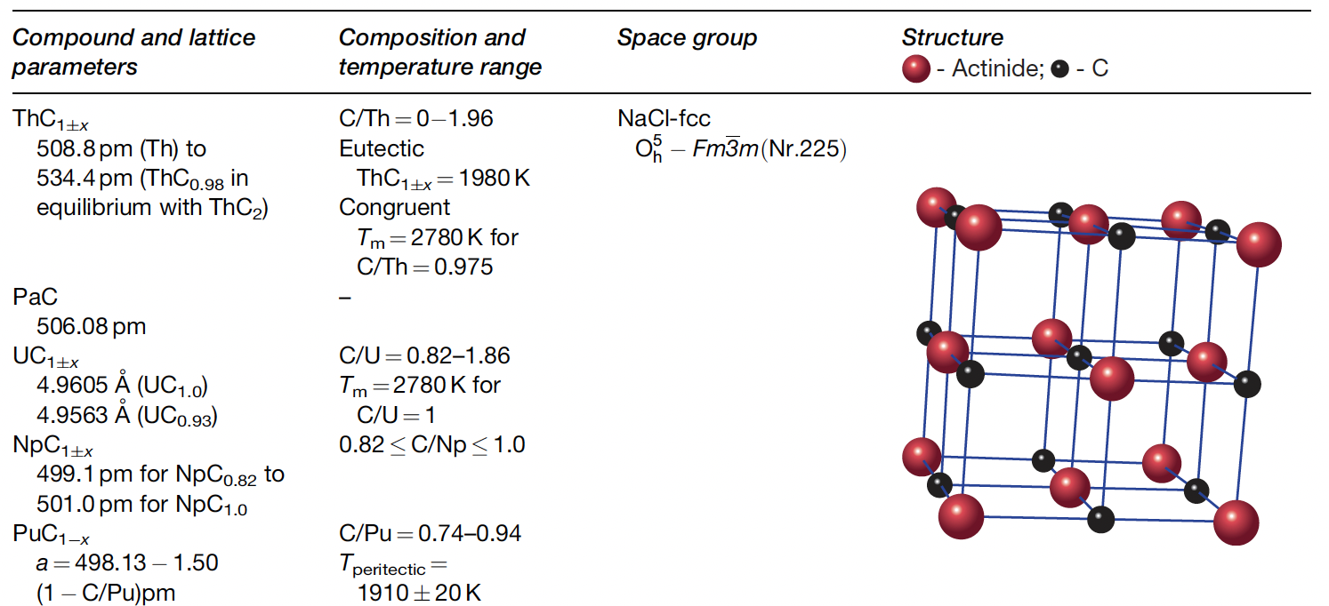
U/Pu-C Phase

Slide 18
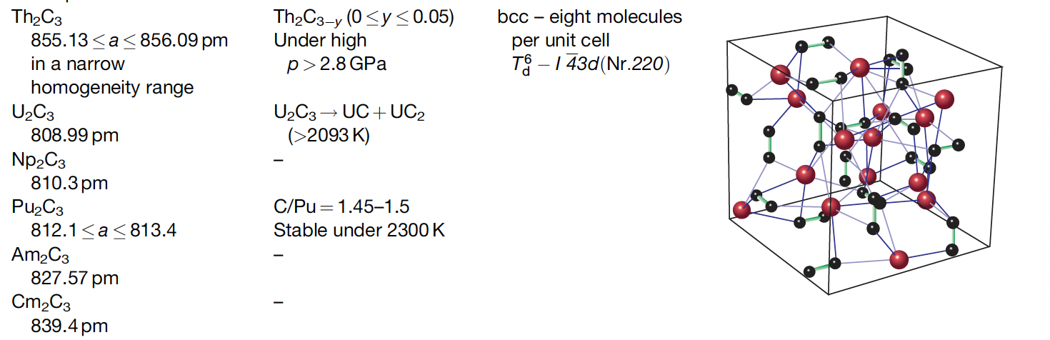
U/Pu2-C3
This structure is more complex than that of the mono- and dicarbides, and is often difficult to form
U2C3 is produced by a complex preparation procedure and decomposes into a mixture of mono- and dicarbides at high temperatures

Slide 19
Phase Properties
UC and PuC are highly dense with fcc octahedral holes occupied by carbon atoms
The brittleness of carbides is due to alternate close-packed planes of metal and nonmetal atoms, restricting the slip and thereby hardening the crystal
Many fission products are not soluble in the monocarbide lattice due to the carbon bonds not wanting to form octahedral ligands
The high density and low FP solubility of UC leads to higher swelling than UO2
The U2C3 phase has more open space in the structure, and generally has less swelling than UC
An increase in O and N impurities results in an increase of carbon activity and CO pressure of the fuel
O impurities are also known to contribute to the actinide redistribution in carbide fuels and fuel restructuring during burnup

Slide 20
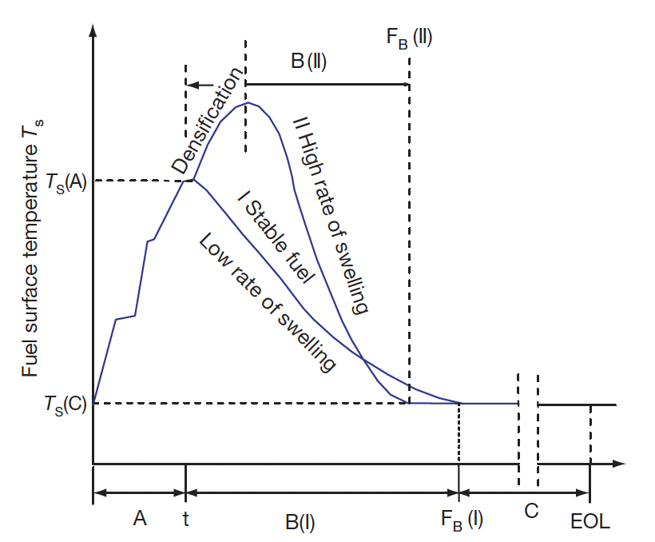
In-pile behavior
The in-pile fuel behavior depends to a large extent on the fuel operating temperature, which in turn depends on the type of pin or bond concept, namely, He-bonded fuel, Na-bonded fuel, or He-bonded particle fuels
A large number of mixed carbide fuels have been irradiated in the US, Europe, Russia, India, and Japan
The performance analysis of the mixed carbide fuel can be best understood based on their burnup period, the structural changes occurring during the burnup and subsequently the swelling of the pin

Slide 21
Burnup Stages
Stage A: At the BOL, the fuel undergoes cracking, which results in the movement of the fragmented fuel toward the cladding surface
The fuel–clad gap partly reduces but does not close
Fuel sees a dramatic increase in temperature
Stage A lasts for a few days
Stage B: Fuel undergoes unrestrained free swelling, crack healing, or resintering
Resintering/densification occurs for thermally unstable fuels, which causes an initial increase in gap size resulting in the rise in the fuel surface temperature
In stage B, free grain boundary swelling occurs and crack healing starts, which results in the relocation of fuel fragments further from the center of the fuel to the periphery

Slide 22
Burnup Stages
Stage B-cont.
Swelling causes fuel–clad gap closure, increase in heat transfer coefficient, and decrease in fuel surface temperature
Surface roughness of fuel and cladding limits complete gap closure
FCMI begins due to the swelling of the fuel
Stage B ends after a burnup of approximately 3 at.%

Slide 23
Burnup Stages
Stage C
This stage starts after fuel–clad gap closure when a steady minimum surface temperature is reached and it continues till the end of fuel life
For carbide fuel, this could be up to 15 at.%
At this stage, more homogeneous fuel–clad interaction starts

Slide 24
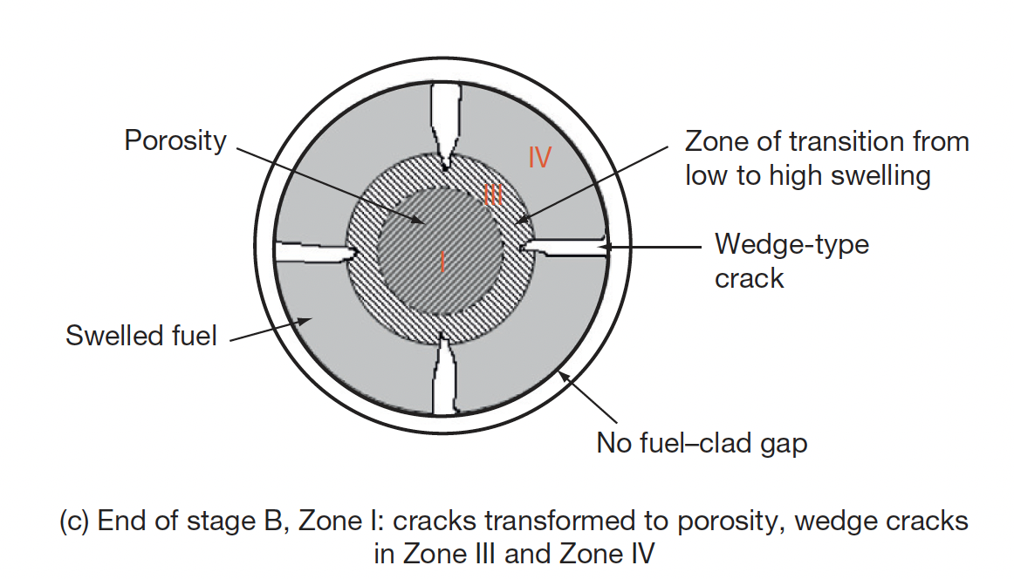
Fuel Restructuring
The cross section can be divided into four structural zones, become well defined when the fuel sees a burnup of 1.3 at.%.
Zone 1 is the porous fuel at the center having high temperature and helps in the release of fission gases
Zone 3 contributes to high microscopic swelling
Zone 2 is an intermediate zone that only exists at very high heating rate (>1200W/cm)
Zone-IV is the coolest zone of the fuel cross section, which is next to the fuel cladding

Slide 25
Na Bonded Pin Performance
For the sodium-bonded fuel pin, the smear density is lower than that of He-bonded fuel
This allows for the manufacture of a denser fuel with less initial porosity
In the beginning (stage A), the fresh fuel fractures, reducing thermoelastic stresses and drastically changing temperature gradient of the fuel
There is no abrupt change in fuel temperature in this concept
The lower temperature of the sodium-bonded pin keeps the swelling rate of the fuel low
The decrease in thermal conductivity with burnup is compensated by a slow decrease in linear heating
FCMI can be avoided till end of life by proper selection of initial fuel–clad gap
Na bond acts like a medium for transfer of C from the fuel to clad, causing clad carburization

Slide 26
He Bonded Pin Performance
He bonding is the most preferred bonding concept of carbide fuel, due to cost and the potential for Na bond deterioration at high burnup
The in-pile performance of the He-bonded pin depends to a large extent on the porosity of the as-fabricated fuel
The initial temperature rise is much higher at the beginning of life because of the lower thermal conductivity of the He bond compared to Na bond
The lower thermal conductivity of the He bond requires the reduction of the fuel–clad gap compared to the Na-bonded fuel
The fuel density for He bonded fuel is lower and has a fabrication porosity of about 15%
The gap closure in the early burnup period results in lowering of the fuel temperature, and free swelling changes into restrained swelling under the contact pressure developed at the clad–fuel interface

Slide 27
Pin Failure
The mechanical properties of the fuel and clad (creep, fracture toughness) largely predict the fuel behavior after gap closure
Cladding breaches due to FCMI or FCCI can be due to loss of ductility of the clad, carburization of the clad, or fuel swelling
Clad carburization makes the clad surface hard and brittle and cracks form and propagate easily
It has been observed that the He-bonded pin can be operated safely up to 15 at.% burnup (peak burnup 20 at.%).

Slide 28
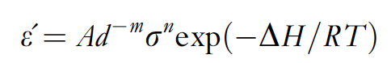
Fuel Creep
The source of stresses in the fuel under irradiation is the pressure generated by fission gases produced within the fuel
After the fuel–clad gap closure, free swelling is restrained, and a back stress is generated by the clad on the fuel
Unlike close-packed metals, deformation of carbide requires much higher stresses because of the strong covalent bonding existing between the metal atom and the carbon atom
Two types of creep deformation are operative in the fuel: temperature-dependent thermal creep and irradiation creep
Thermal creep has been shown to start at 1000C and dominate over radiation-induced creep
The steady-state creep curve has been determined and is a function of stress, temperature, composition, grain size, and impurity content in the fuel

Slide 29
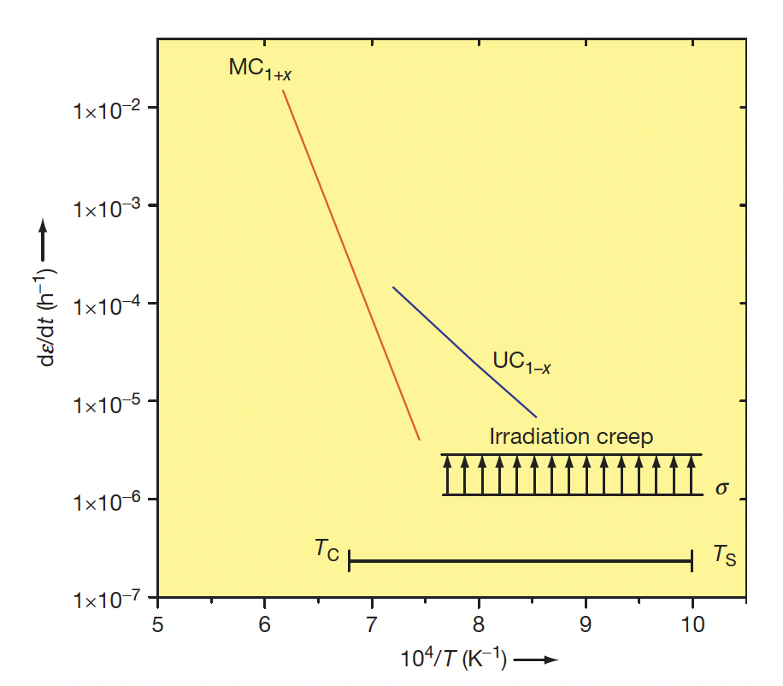
Fuel Creep
Steady-state creep data of UC_{1-x} and MC_{1+x} at a stress of 20 MPa
Substantial creep only exists for a limited part of the fuel, and thus most of the fuel acts as a brittle material
Irradiation-induced creep is independent of temperature, but increases with fluence
No data on creep of U/Pu-C or Pu-C fuel exists

Slide 30
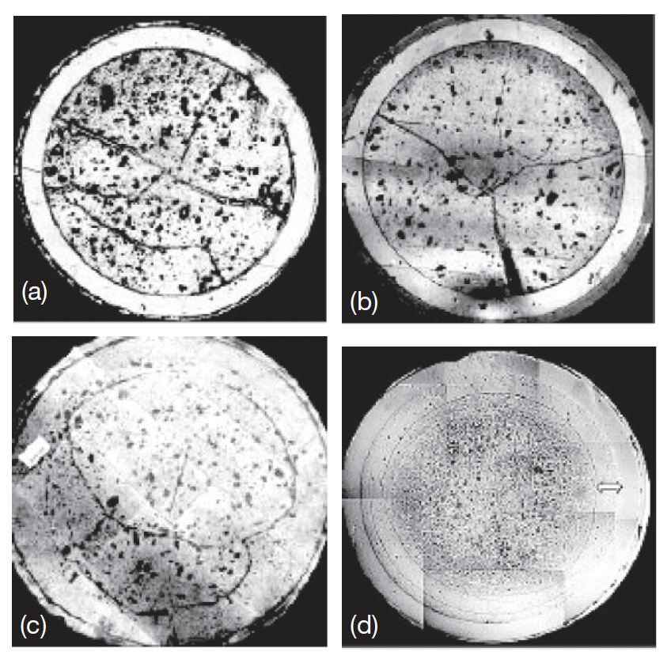
Irradiation Performance
Carbide fuel containing 70% and 55% PuC was used as the driver fuel for FBTR
PIE at burnups of 2.5, 5, 10, and 15.5 at.% shows the evolution of the pin
After 10 at.% burnup, the gaps had closed at the center of the fuel column
Circumferential cracks due to thermal stresses formed, and a discrete zone free from any porosity is observed near the outer region

Slide 31
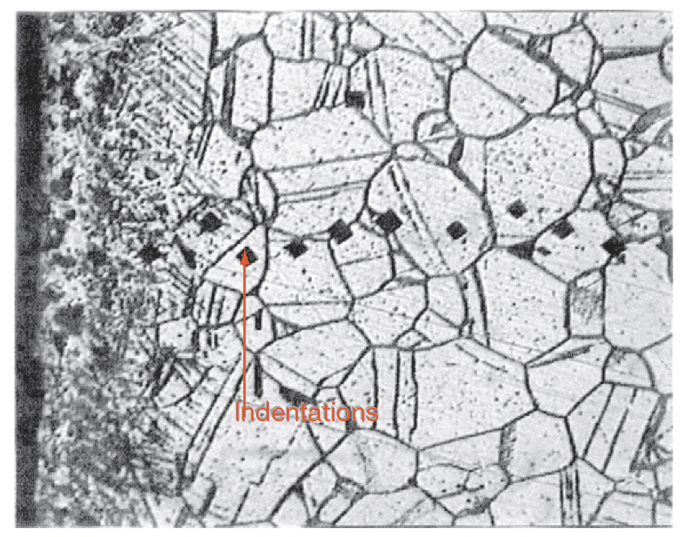
FCCI
Carbon activity and partial pressure of CO are important parameters responsible for clad carburization
In sodium-bonded fuel, carbon transfer from the fuel to the clad takes place by dissolution of carbon in sodium liquid
In He-bonded fuel pins, carbon transfer takes place through CO
Out-of-pile testing with Na-bonded fuel showed carburization above 1000 K, with hardening of the SS316 cladding up to 100 μm
Carburization typically takes the form of carbide precipitation along the grain boundaries and slip lines
The depth of carburization in Na-bonded fuel was greater than in the He-bonded pins

Slide 32
C/M Ratio
The fission of uranium–plutonium MC results in the formation of different types of fission products
The fission products generated may form dicarbides or monocarbides depending upon the carbon potential in the fuel
This may cause decrease in the C/M ratio and result in the formation of metal phase U/Pu, which forms low-melting eutectic with the components of the cladding material
Thus, a hyperstoichiometric fuel is always preferred for carbides
The extent of hyperstoichiometry (M2C3 content) in the initial fuel composition is determined by the target burnup, with additional C required for longer burnups
Thermodynamic calculations have shown that rare earth elements show more solubility in M2C3 than in the
MC phase of the fuel, and that lanthanides make stable sesquicarbides and dicarbides

Slide 33
Carbide Fabrication
Fabrication of carbide fuel on commercial scale is a difficult task and needs additional care because of its pyrophoricity, high radio toxicity, and the concern for criticality restricts the batch size
Carbide powders formed during carbothermic reduction of oxides are prone to oxidation and hydrolysis
This requires high-purity inert-gas cover in the fabrication line consisting of glove boxes

Slide 34
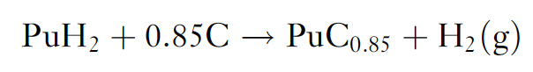
Fabrication Techniques
Melting casting
In this method, UO2 or U metal chips with graphite are arc-melted and made into the form of a button
Melting casting route results in large-grained materials compared to that obtained by powder metallurgical methods
The melting casting method is, however, uneconomical due to the high cost of metal fabrication
Metal hydriding– dehydriding
This method is followed for small-scale production of high-purity carbides, where the metal hydride reacts with graphite
Actinide carbides MC and M2C3 can be prepared from a mixture of hydride and graphite
For UC, the reaction between uranium metal and a hydrocarbon gas (methane) is carried out with careful control of the hydrocarbon flow

Slide 35
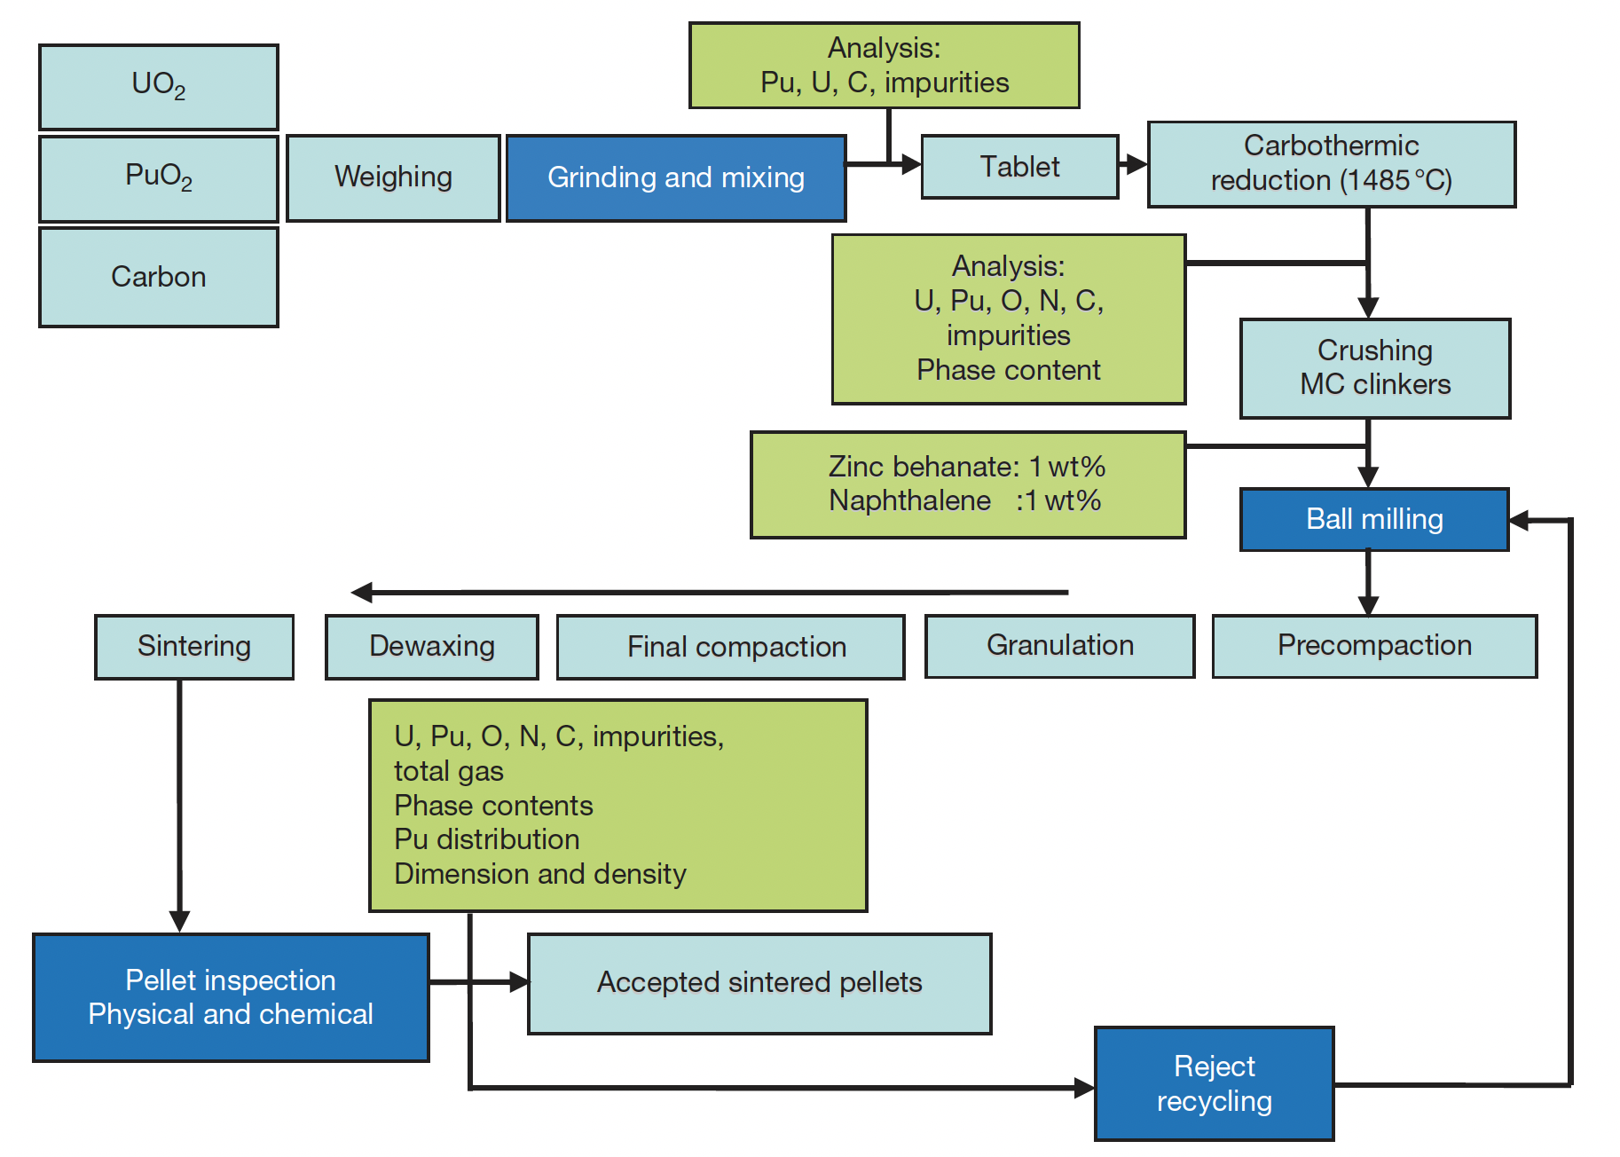
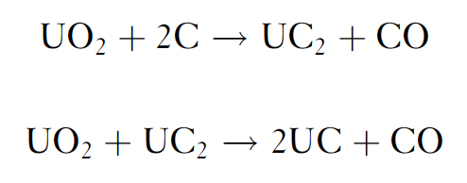
Carbothermic Reduction
Uranium monocarbide is produced by carbothermic reduction of UO2 and carbon following the reaction
A mixture of UO2 and carbon is blended together and the mixture is compacted at 300–600MPa pressure along with an organic binder
The pellets are heated in a vacuum induction furnace and ground to a powder for compaction

Slide 36
Carbothermic Reduction
Uranium–plutonium-mixed carbide is also prepared by carbothermic reduction of UO2–PuO2
The reaction is complicated by the uneven distribution of plutonium in the two carbide phases and the formation of CO2 and CO, especially in hyperstoichiometric feedstock
Pu can volatilize and evaporate, which needs to be controlled via increased CO partial pressure

Slide 37
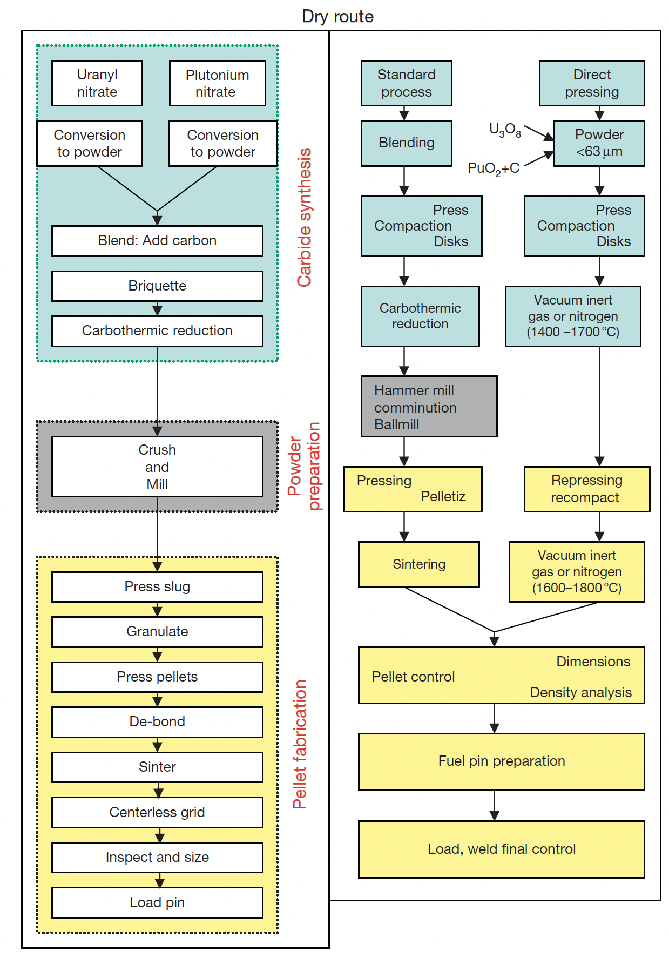
Pressing
The conventional powder metallurgy route of carbide fuel fabrication has certain disadvantages, including pick up of O impurity from the cover gas and risks of pyrophoricity
Direct pressing takes the product of carbothermic reduction and presses them into a low density pellet, which can be sintered into the final product
This reduces O pickup, reduces dust and impurities, and reduces time/cost
There is an additional route that involves wet processing of nitrate-based fuels in a sol-gel technique

Slide 38
Summary
Key thermophysical properties includes thermal conductivity, CTE, creep, etc., and vary strongly based upon composition
Two primary phases: UC and U2C3
Three stages in burnup that affect centerline temperature
Fuel restructures into typically three zones with variable porosity
Carburization of cladding is the key FCCI phenomenon
Control of C/M ratio via initial hyperstoichiometry prevents low melting metal phases forming
Carbothermic reduction is primary fabrication route

